Slide 1
Smart Grid Implementation in India
Experiences and Learnings
Arup Ghosh
Sr Advisor and Director
arup.ghosh@tatapower-ddl.com

Slide 2
  Presentation Structure
1. Smart Grid Maturity Model
  Overview
  Domains and Levels
2. Integration of
OT and IT
  Areas
  Challenges and Solutions
3. Smart Grid Journey
  Technologies implemented
  Time lines
4. Results
  Operational & Financial
  SGMM Maturity

Slide 3
  Smart Grid Maturity Model - Overview
1
2
3
SGMM is a management tool that:
Provides a common framework to Utilities for defining key elements of smart grid;
Helps Utilities develop a prioritized & programmatic approach;
Enables Utilities to measure and track progress in their smart grid journey.
Global Intelligent Utility Network Coalition (GIUNC) developed SGMM and it is currently under the stewardship of the Software Engineering Institute at Carnegie Mellon University
Source: SEI http://www.sei.cmu.edu/smartgrid/

Slide 4
  Smart Grid Maturity Model - Domains
1
2
3
SMR
Strategy, Mgmt & Regulatory
TECH
Technology
Vision, planning, governance, stakeholder collaboration
IT architecture, standards, infrastructure, integration, tools
OS
Organization and Structure
CUST
Customer
Culture, structure, training, communications, knowledge mgmt
Pricing, customer participation & experience, advanced services
GO
Grid Operations
VCI
Value Chain Integration
Reliability, efficiency, security, safety, observability, control
Demand & supply management, leveraging market opportunities
WAM
Work & Asset Management
SE
Societal & Environmental
Asset monitoring, tracking & maintenance, mobile workforce
Responsibility, sustainability, critical infrastructure, efficiency
Source: SEI http://www.sei.cmu.edu/smartgrid/

Slide 5
  Smart Grid Maturity Model - Levels
1
2
3
5
Pioneering
Breaking new ground; industry-leading innovation, benchmark.
4
Optimising
Optimising smart grid technologies to bring about measurable performance improvements.
3
Integrating
Integrating smart grid technology deployments across the organization.
2
Enabling
Capex based on clear strategy, implementing initial projects to start building smart grid
1
Initiating
Taking the first steps, exploring options, conducting experiments, developing smart grid vision.
0
Default
Default level (status quo).
Source: SEI http://www.sei.cmu.edu/smartgrid/

Slide 6
  Presentation Structure
1. Smart Grid Maturity Model
  Overview
  Domains and Levels
2. Integration of
OT and IT
  Areas
  Challenges and Solutions
3. Smart Grid Journey
  Technologies implemented
  Time lines
4. Results
  Operational & Financial
  SGMM Maturity

Slide 7
  OT & IT Convergence – Process silos
1
2
3
Historically, OT and IT in electricity distribution have been developed, maintained, and used in silos.
Manual interfaces between the silos does not support efficient operation of the distribution system.
Business processes require re-engineering for integrated functioning of OT and IT.
Full benefit of smart grid can only be derived after reasonable integration of IT and OT.

Slide 8
  OT & IT Convergence – Identification
1
2
3
IT
OT
Defining IT-OT
for Utilities
Billing, CRM, Planning, Business processes management, Resource allocation.
Enterprise Resource Planning;
Enterprise Asset Management;
Mobile Workforce Management;
Customer Information Systems;
EMS
SCADA
GIS
DMS
Asset Management
Substation Automation
Execution, monitoring and control of the electric system.
Drivers for IT-OT Convergence
1
2
3
Manual interface between processes cause delay, errors and inefficiencies.
SG techs generate large quantity of information – IT/OT systems need to be integrated to quickly sort through and identify relevant data points.
Information stored in different silos need to be synchronized to enable unified view, analysis and control.

Slide 9
  OT & IT Convergence – Example
Convergence of IT-OT
Traditional Scenario
1
2
3
Asset Health Monitoring & Maintennace – Real time monitoring of health of all assets in a network and preventive maintenance
Enterprise Asset Management
Stored Asset Data
Enterprise Asset Management
Real time asset data - SCADA
Predictive Analytics > Forecasts equipment performance trend
Work Order > Maintenance based mostly on output from predictive analysis.
Maintenance based mostly on manufacturer specifications or some standard maintenance periodicity
Work Management System (WMS)
In traditional scenario - no consideration of actual working or loading conditions, connectivity, operational parameters, etc.
EAM (IT) gets near real time data from SCADA (OT)
Applications predict maintenance requirement, trending and forecast equipment performance.
Data Analysis yields techno-economic impact of asset’s performance on. Remedial actions conveyed to field staff.
Key
IT
OT
Source: ABB: Convergence of Information and Operation Technologies (IT & OT) to Build a Successful Smart Grid

Slide 10
  Presentation Structure
1. Smart Grid Maturity Model
  Overview
  Domains and Levels
2. Integration of
OT and IT
  Areas
  Challenges and Solutions
3. Smart Grid Journey
  Technologies implemented
  Time lines
4. Results
  Operational & Financial
  SGMM Maturity

Slide 11
  Technologies – Implementation Timelines
1
2
3
2005
2009
2011
2015
2020
Phase 1
Phase 2
Phase 3
Phase 4
Grid Station Automation;
SCADA;
Comm Infra-structure;
GIS;
Billing (Legacy);
Asset Mgmt;
Network Analysis Tool;
AMR;
ERP (SAP – R3).
Dist Automation;
DMS / OMS;
Billing & CRM (SAP – ISU/CCS);
Integration of Enterprise Applications;
Integrated Asset Mgmt;
Distributed Gen Integration pilots;
PoC of PLCC and Wireless Comm.
Distributed Generation Integration;
DSM;
DR;
Workforce Management (WFM);
Mobility.
Comm Canopy with Radio+OF;
AMI;
Big Data Mgmt;
Business Analytics;
Extensive Mobility Solutions;
Power Mgmt.
SGMM - Level 3
Score # 3.6
SGMM - Level 4
Score # 4.5
SGMM - Level 1
Score # 1.69
SGMM - Level 2
Score # 2.5

Slide 12
  Technologies – Thematic Representation
1
2
3
Extensive Customer Interaction
Business Efficiency
  Real time pricing;
  Integrated outage mgmt;
  Business Analytics.
  Home energy mgmt;
  Gathering structured and unstructured data;
  Separation of carriage and content;
  Field Force Automation
  Extensive roof-top solar integration;
Basic Business Needs
  In-home displays;
  Net metering/ solar;
  Spatial technologies.
  Integrated disconnect
  Advanced Asset Mgmt.
  Predictive maintenance;
  Advanced fault monitoring;
  Demand Mgmt (DSM & DR);
Cumulative benefits
  Billing;
  Prepayment;
  Meter reading;
  Theft detection;
  Plant Maintenance;
  Asset Management;
  Network automation;
  Outage management.
  Technology Complexity

Slide 13
  Technologies – Implementation Challenges
1
2
3
Designed for western world > To suit local business environment needed extensive local customization;
Costs in tune with western economies > Localisation and redesign to meet local affordability;
Lack of developing world benchmark and implementation expertise > Extended implementation timelines > Trial and error;
Lack of experienced human resource > Build up extensive in-house capabilities > Impacts implementation timelines.

Slide 14
  Presentation Structure
1. Smart Grid Maturity Model
  Overview
  Domains and Levels
2. Integration of
OT and IT
  Areas
  Challenges and Solutions
3. Smart Grid Journey
  Technologies implemented
  Time lines
4. Results
  Operational & Financial
  SGMM Maturity

Slide 15
  Results – Initial challenges
1
2
3
1,00,000 Billing Complaints affecting 15% of the customer base.
Absence of Customer Relationship Management processes.
Regular Power Cuts, Black Outs & Brown Outs.
20,000 applications pending for New Connections for years.
No Digitization.
50% of customers database had some form of error
Nothing moved unless long hours were spent standing in queues

Slide 16
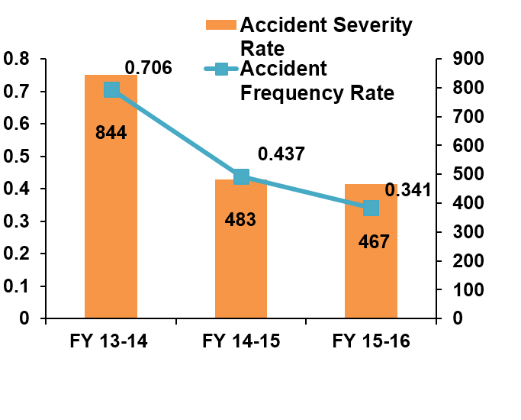
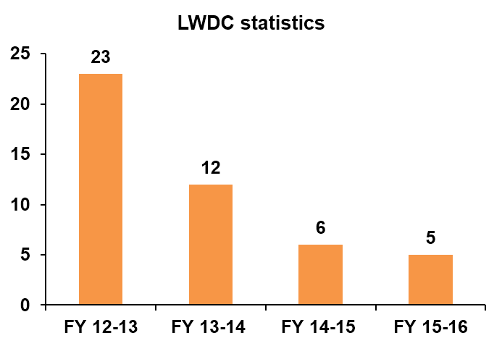
  Results – Human Resource
1
2
3
Parameter | Unit | Jul 02 | Mar 16 | % change
Human Resource Performance
Energy sold per employee | MU | 0.4 | 2.2 | 456%
Max Demand met per employee | kW | 188 | 508 | 171%
Employee Engagement Index | Index | 65% (FY 07) | 79% (FY 15) | 21.5%

Slide 17
  Results – Operations & Customers
1
2
3
Parameter | Unit | Jul 02 | Mar 16 |  | % change
Operational Performance
AT&C Losses | % | 53.1 | 8.88 |  | -83%
System Reliability – ASAI | % | 70 | 99.68 |  | 42%
System Reliability – SAIDI / SAIFI | Hours/ Nos | 1200 / 1000 | 28 / 42 |  | -94%
Transformer Failure Rate | % | 11 | 0.61 |  | -94%
Peak Load | MW | 930 | 1768 |  | 90%
Street Light Functionality | % | 40 | 99.4 |  | 149%
Consumer Related Performance
No of Customers | Nos in Lacs | 7 | 15.15 | 116%
New Connection Energization Time | Days | 51.8 | 5 | -90%
Meter Replacement Time | Days | 25 | 4 | -84%
Provisional / Defective Billing | % | 15 / 6 | 1.3 / 0.14 | -91%/ -98%
Bill Complaint Resolution | Days | 45 | 4 | -91%
Call Center Service Level | % in 20 Secs | - | 92 | -
Payment Collection Avenues | Nos. | 20 | 6,725 | 33525%
Consumer Satisfaction Index (Top 2) | % | - | 86 | -

Slide 18
Thank You arup.ghosh@tatapower-ddl.com

