Slide 1
Smart Grid
Demonstration
in City Subdivision of Panipat
17th August, 2016
Fuji Electric Co., Ltd.

Slide 2
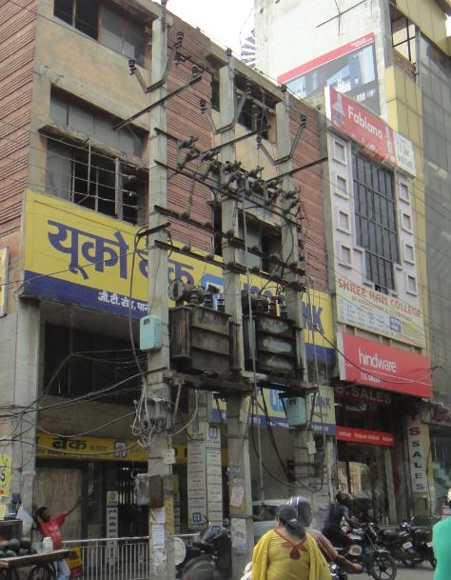
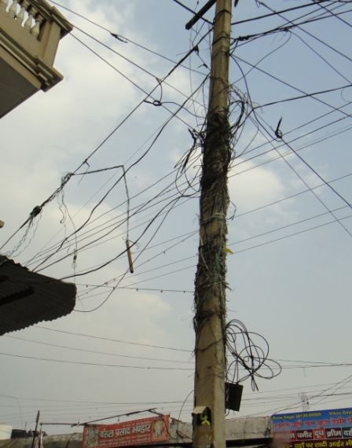
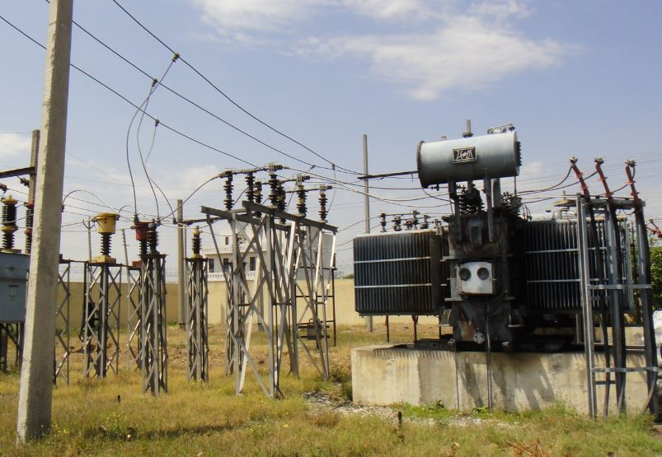
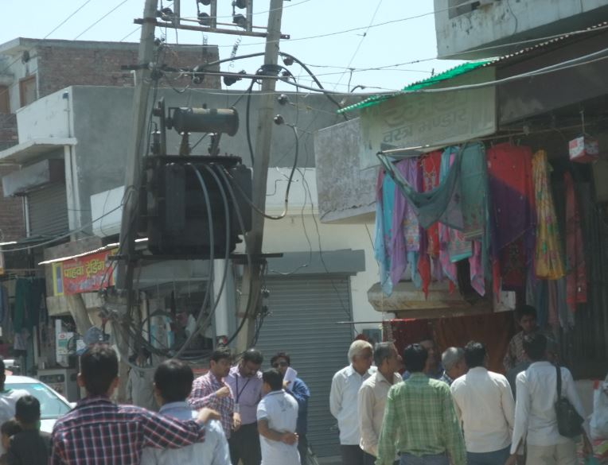
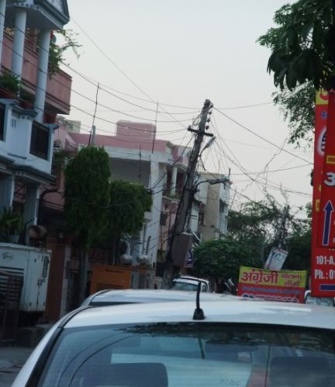
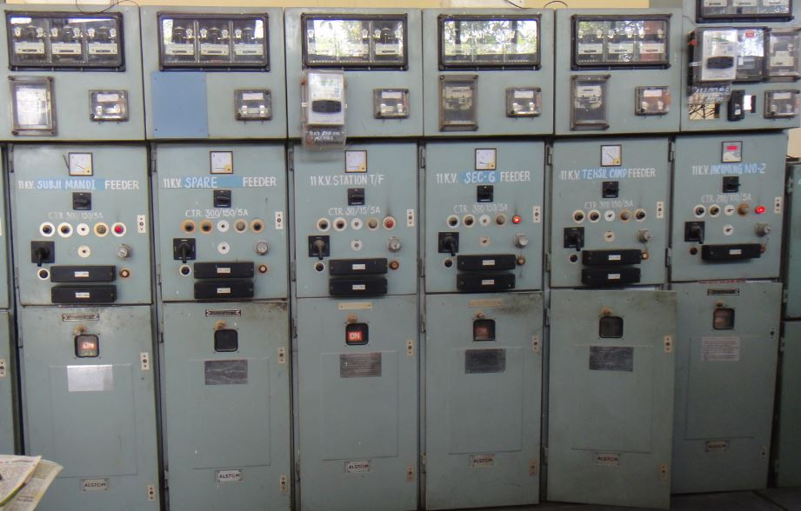
Challenge of
India Power Distribution Companies
[Challenge]
1. Outage Management
2. Peak Load Management
3. Smart Meters
4. Capacity Building

Slide 3
Improvement of KPIs
Improvement of reliability SAIFI/SAIDI
by Multi-divided-Multi-connected network – Knowledge from TEPCO
Reduction in Distribution Transformer Failure Rate through TEPCO Technical Knowhow
AT&C Loss Reduction using Smart Meters
SAIFI : System Average Interruption Frequency Index
SAIDI : System Average Interruption Duration Index

Slide 4
Smart Grid Project Overview
Target country and areas
: Republic of India, Haryana State, Panipat City
Distribution company
: UHBVN (Uttar Haryana Bijli Vitran Nigam)
Demonstration period
: September 2015 - March 2019
Demonstration scale (expense)
: JPY 2,196 million (Including TAX)
Demonstration scale (target device)
: 4 feeders, 11,000 smart meters
Project scope
: Peak Load Reduction, Distribution System Monitoring and Control, Power Distribution Loss Reduction

Slide 5
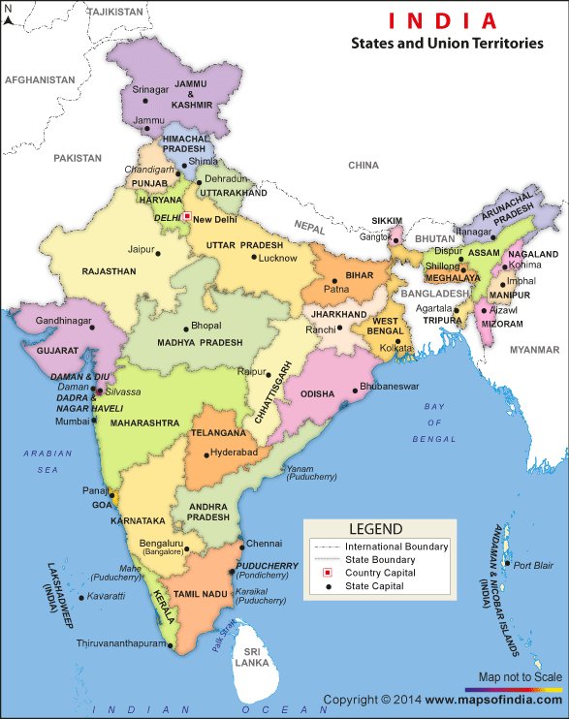
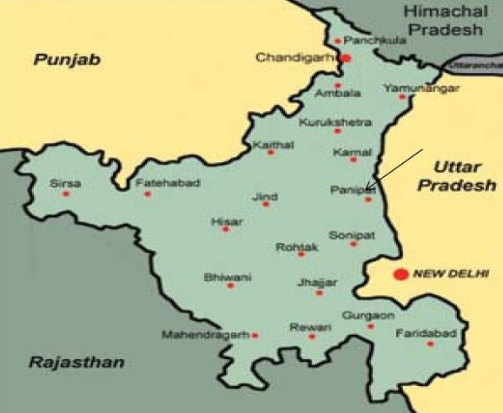
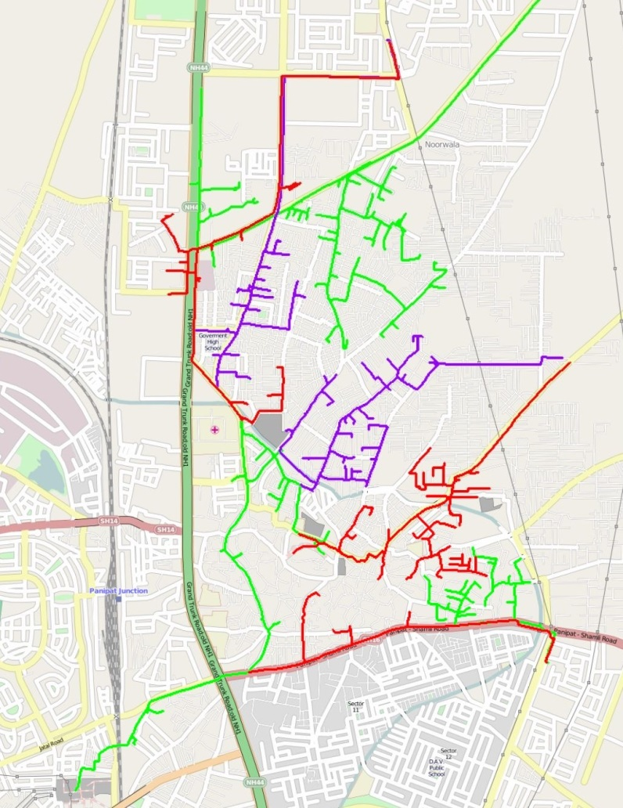
Panipat City, Haryana State
Chandigarh
Panipat
100km
New Delhi
UHBVN (Uttar Haryana Bijli Vitran Nigam)

Slide 6
Smart Grids Feeder Management
Multi divided and multi connected distribution network
Current Feeder Network
Feeder_1
Feeder_1
Feeder_2
Feeder_2
Feeder_3
Feeder_3
Feeder_4
Feeder_4
: GO switch
: New switch
: New HT Feeder

Slide 7
Feeder Structure
Sabji Mandi
Skylark
Tehsil
13-17
Noorwala
Conduit
Devi Mandi
Mini
Secretariat
Salarganj
Vishwa Karma
Panipat
City-1
G T Road
Shree Ram

Slide 8
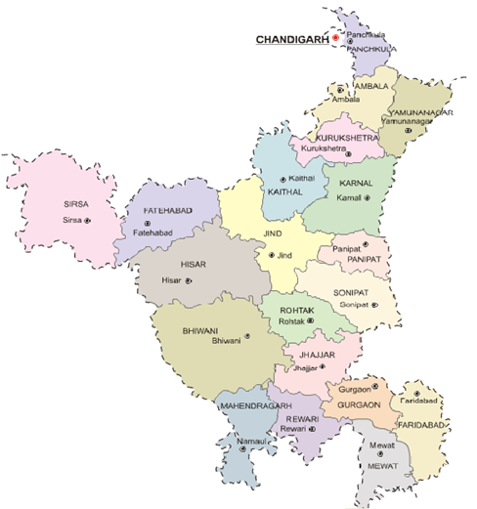
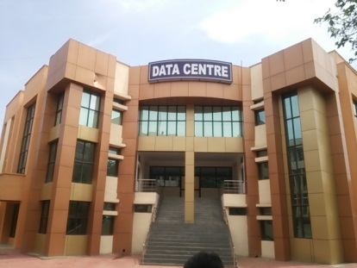
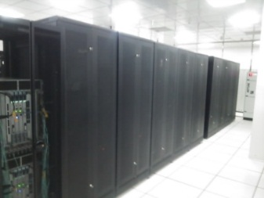
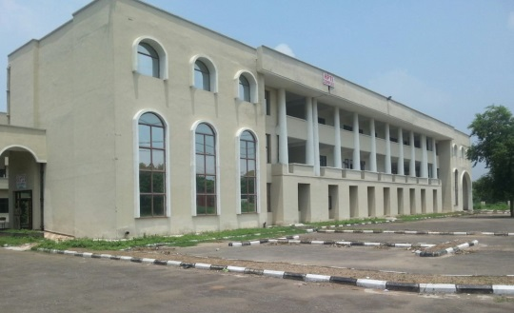
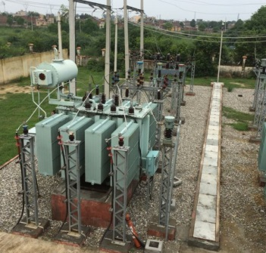
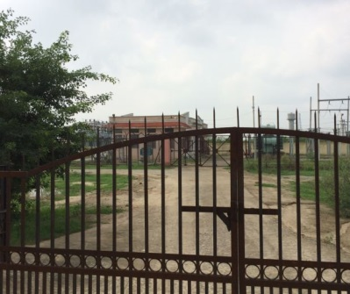
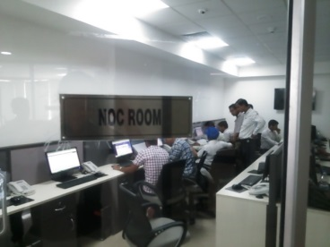
Smart Grid System Facilities
Hisar Data Center
Haryana Power Training Institute
(HPTI)
Chandigarh
Haryana Power
Training Institute
(HPTI: Panchkula)
Demonstration Room
Training Room
Switchgear
Substation Panel
Smart Meter
New Delhi
Panipat Operation Center

Slide 9
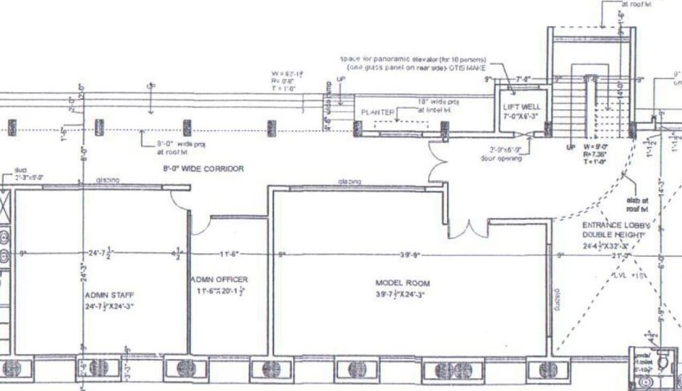
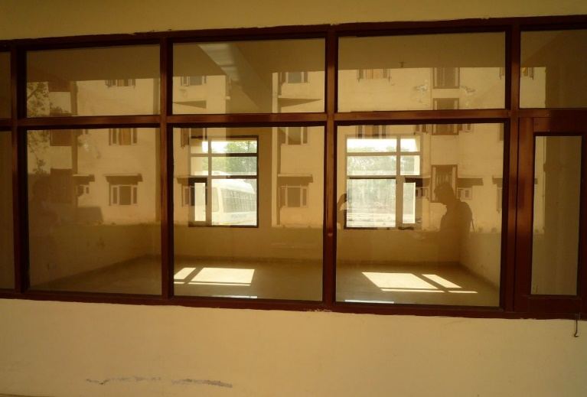
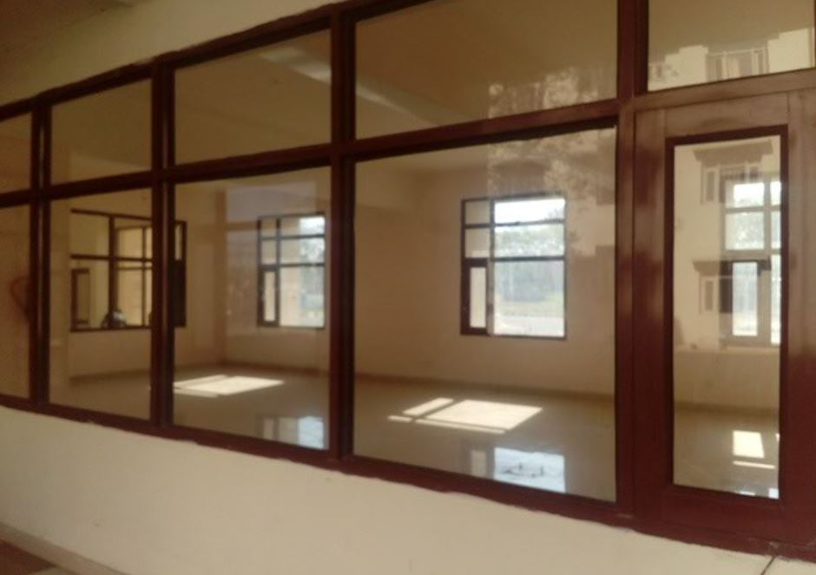
HPTI Demonstration Room
System
Equipment
Room
24.3ft = 7.40m
Server
Room
Indoor Equipment
Room
24.75ft = 7.54m
11.6ft = 3.54m
39.9ft = 12.16m
76.25ft = 23.24m

Slide 10
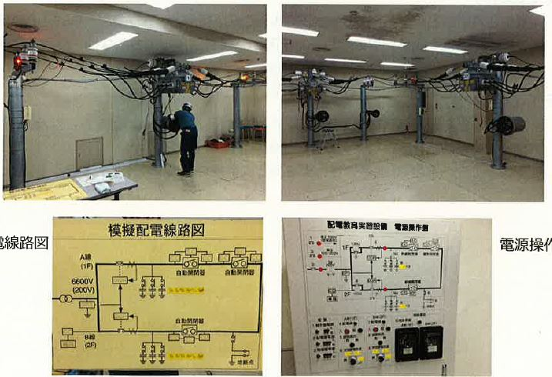
TEPCO Training Center
VCB Panels / LBS / Smart Meters for Capacity Building
Single Line
Diagram
Power Control
Panel

Slide 11
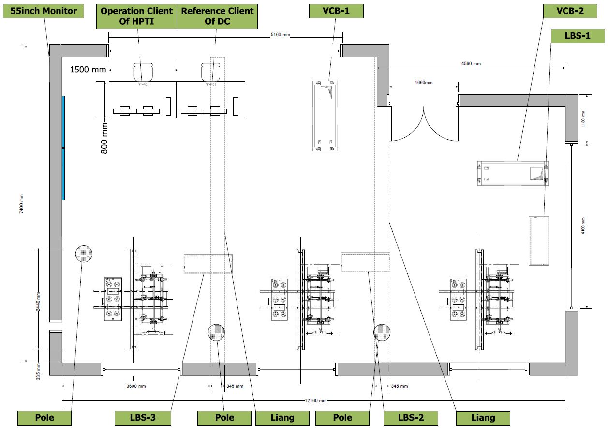
Indoor Equipment Room Layout

Slide 12
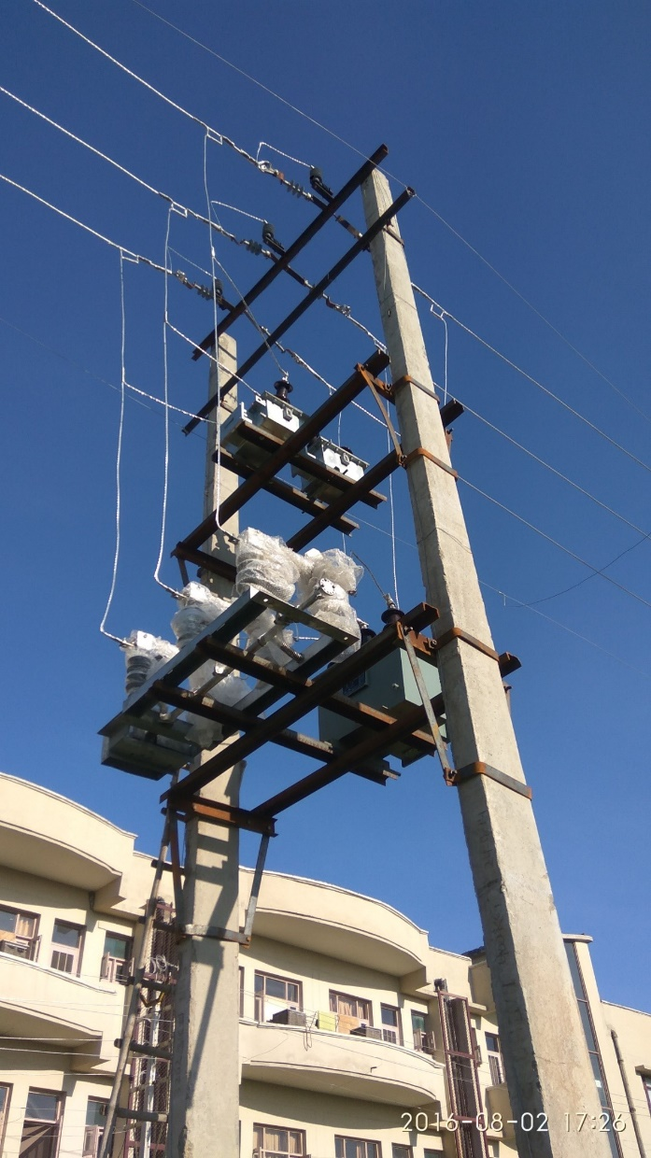
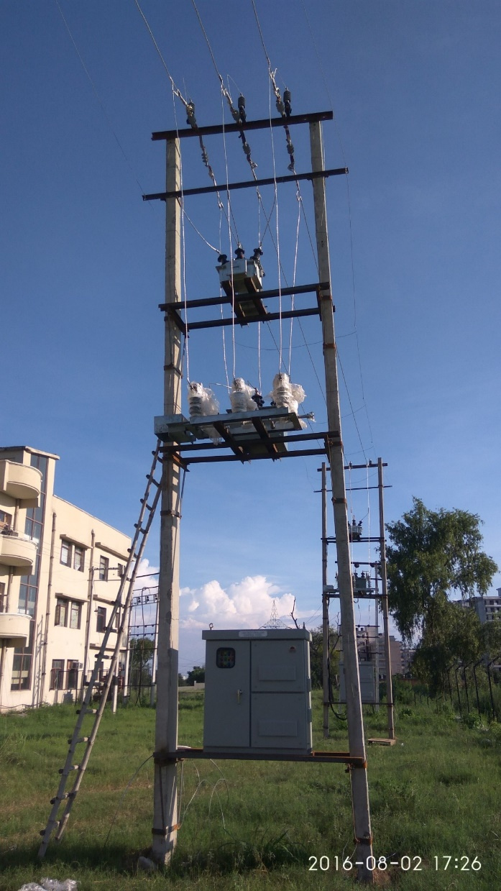
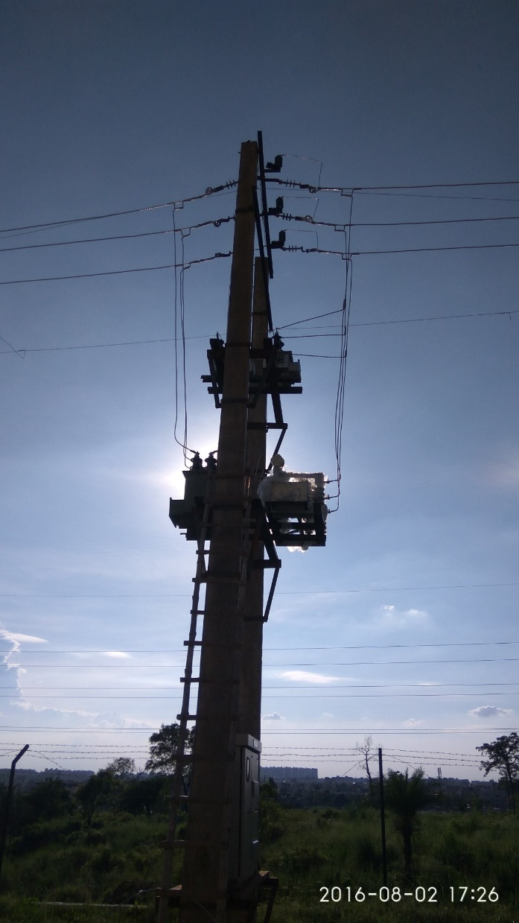
LBS on Double Pole for Training

Slide 13
11,000 Smart Meters
RF Mesh Smart Meters
  4,900 : Single Phase Smart Meter
  600 : Three Phase Smart Meter
  RF Mesh : Primary Communication Platform
  GPRS : Secondary Communication Platform (for Backup)
TWACS Smart Meters
  4,900 : Single Phase Smart Meter
  600 : Three Phase Smart Meter
  TWACS : Supplementary Communication Platform
  RF Mesh : Primary Communication Platform
  GPRS : Secondary Communication Platform (for Backup)
  DCU : Requires additional 5,500 RF Mesh

Slide 14
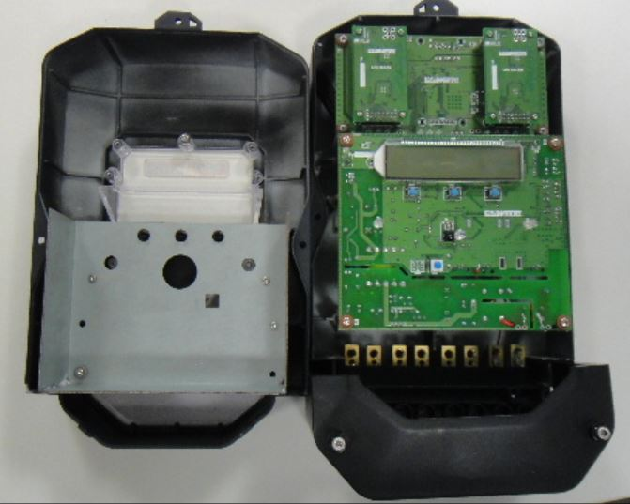
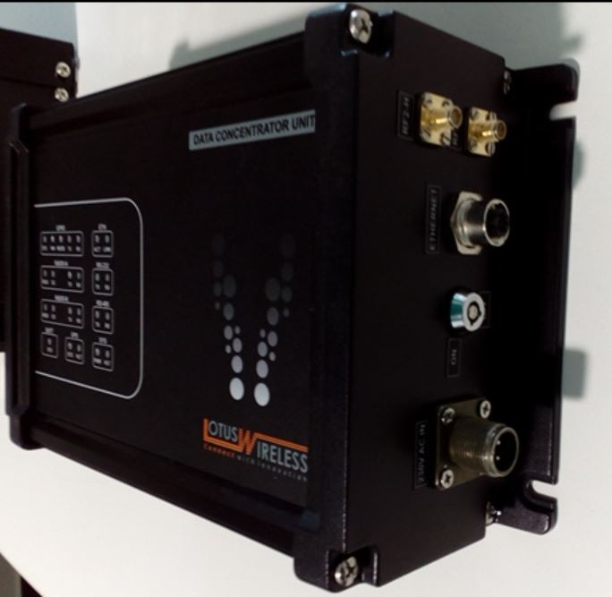
Smart Meter – RF Mesh & DCU
Data Concentrator Unit (DCU)
for RF Mesh
Waiting for BIS Final Approval on September 2016

Slide 15
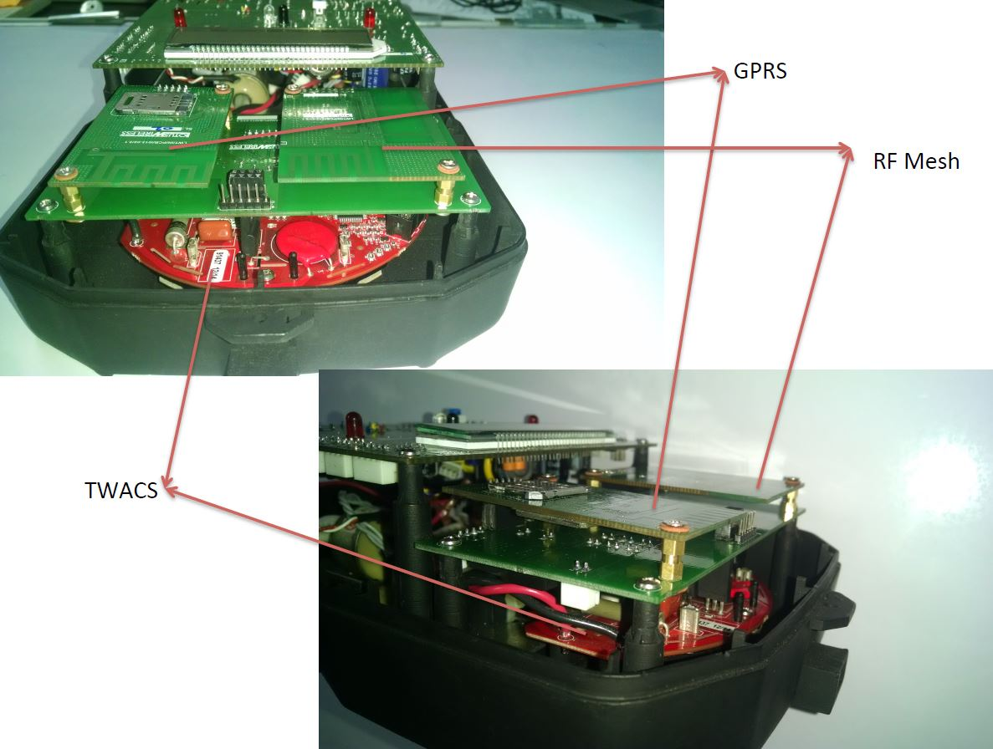
Smart Meter 3 Communication Board
GPRS
RF Mesh
TWACS

Slide 16

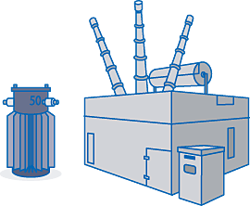


System Structure
Power plant
System Integration
Billing System
(UHBVN)
Server Equipment
MDMS
OMS/
PLM
SCADA
Head End System
Substation
Radio Communication/GPRS(2G/3G)/TWACS(PLC)
LBS
LBS
(Load Breaking
Switch)
VCB Panel
Smart
Meter
SM
SM
SM
SM
SM
SM
SM
SM
SM
SM
SM

Slide 17
Fuji Electric Smart Community Project in INDIA
Smart Grid in Panipat,
Haryana State
New Smart City,
Maharashtra State
New Smart Capital,
Andhra Pradesh State

