Slide 1


Indian Smart Grid Journey
August 17, 2016
National Smart Grid Mission
Ministry of Power, GoI

Slide 2
Smart Grid Vision for India
Journey till date
Smart Grid Projects in India
Status of Pilots
About NSGM
Smart Grid Challenges & Opportunities
CONTENTS

Slide 3

Smart Grid Vision for India
“Transform the Indian power sector into a secure, adaptive, sustainable and digitally enabled ecosystem that provides reliable and quality energy for all with active participation of stakeholders”

Slide 4
Journey till date – 1
Realizing the growing importance of Smart Grid technologies in the Indian power sector, the Ministry of Power (MoP) had taken early steps in 2010 by constituting the India Smart Grid Task Force (ISGTF) and the India Smart Grid Forum (ISGF).
India Smart Grid Task Force
India Smart Grid Forum
Pilot Projects
Inter-ministerial group created under MoP to provide policy direction to the Smart Grid initiatives in the country.
Non-profit voluntary consortium of public and private stakeholders with prime objective of accelerating development of Smart Grid technologies in Indian Power Sector.
11 Smart Grid and 1 Smart City pilots sanctioned with 50% funding support from MoP, GoI to test various Smart Grid technologies.
There are also several additional initiatives that various entities have been undertaking working in their domain for Smart Grid support and implementation in India such as CEA, BIS, CPRI, BEE, etc.

Slide 5
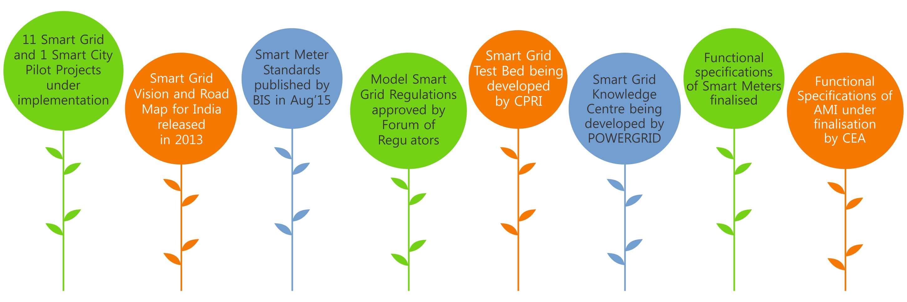
Journey till date – 2
l

Slide 6
Overview of Smart Grid Pilots/Projects Across Country
S.N. | Project Description | Project Area | Cost ₹Cr | Consumers
1 | 11 Smart Grid Pilots (WIP) | Across India | 333.2 | 1,84,801
2 | IIT Kanpur Smart City Pilot (WIP) | IIT Kanpur | 12.5 | IIT Campus
3 | Smart Grid Projects under NSGM (WIP) | Amravati, Congress Nagar (Nagpur) & Chandigarh | 257.8 | 3,03,341
4 | Smart Grid Project by BESCOM (WIP) | Indira Nagar (Bangalore) | N.A. | 26,911
5 | SG project at TPDDL (WIP) | Delhi | N.A. | 5,000 endpoints in phase 1
 |  |  | N.A. | 160 buildings
6 | Smart Grid Project by CESC (WIP) | Kolkata | N.A. | 1st ph- 1,87,000 Total- 7,50,000
7 | Smart Prepaid Metering on BOOT Model | Across Odisha | N.A. | 1stPhase-4,237
 |  |  |  | Total- 18,046
8 | Smart Grid Demonstration Project by POWERGRID | Puducherry | N.A. | 1,658 Meters
9 | Smart Grid Pilot - PoC by UGVCL | Naroda (Ahmedabad) | N.A. | 1,500 Meters
11 | Meerut AMI project (WIP) | Meerut (UP) | N.A. | 13,751 Meters
12 | Gaya (Bihar) WIP | Gaya (Bihar) | N.A. | 10000 Meters
13 | Muzaffarpur AMI project | Muzaffarpur (Bihar) | N.A. | 5,000 Meters
14 | Tata Power AMI project | Mumbai | N.A. | 10,170 Meters

Slide 7
Status of Pilots – Snapshot
Sl. No. | Smart Grid Pilot | Date of Award | Sanctioned Cost ₹ Crores | Financial Progress ₹ Crores | Households Covered
 |  |  |  |  | Total Qty | Progress Upto July
1 | CESC, Mysore SGIA - Enzen | Mar'14 | 32.59 | 4.07 | 21824 | 15566
2 | HPSEB, Himachal Pradesh SGIA – Alstom | Feb'15 | 19.45 | 2.43 | 1554 | 1061
3 | UHBVN, Haryana SGIA - NEDO Japan | Apr'14 | NA | NA | 11000 | 0
4 | APDCL, Assam SGIA - Phoenix IT | Mar'15 | 29.94 | 2.61 | 15083 | 0
5 | PSPCL, Punjab SGIA - Kalkitech | Mar'15 | 10.11 | 0.89 | 2737 | 0
6 | WBSEDCL, West Bengal SGIA - Chemtrols | Jun'15 | 7.03 | 0.88 | 5265 | 0
7 | TSECL, Tripura SGIA - Wipro | Sep'15 | 63.43 | 7.93 | 45029 | 69
8 | TSSPDCL, Telangana SGIA - ECIL | Oct'15 | 41.82 | 00 | 10397 | 0
9 | PED, Puducherry SGIA - Dongfang | May'16 | 46.11 | 00 | 33499 | 0
10 | AVVNL, Ajmer | Sep'15 | NA | NA | 1000 | 1000
11 | UGVCL, Gujarat | NA | 82.70 | 00 | Yet to be awarded
SGIA – Smart Grid Implementing Agency

Slide 8

National Smart Grid Mission
The Government of India approved the establishment of a National Smart Grid Mission (NSGM) in Power Sector. (OM issued on March 27, 2015)
NSGM to plan and monitor implementation of policies and programmes related to Smart Grid activities in India.
NSGM - Project Management Unit (NPMU) housed in POWERGRID -Single point contact for GoI’s views on Smart Grid.
NSGM will have its own resources, authority, functional & financial autonomy.
The total outlay for NSGM activities for 12th Plan: Rs.980 crore with a budgetary support of Rs.338 crore.

Slide 9
NSGM – Three Tier Structure
Tier – I
Tier – II
Tier – III
State Level
Chair:
Minister (MoP)
Chair:
Secretary (MoP)
Director, NSGM
Policy, Planning & Monitoring Unit
Distribution Utilities
State Level Project Management Unit
Chair: State Secretary (Power)
Governing Council
Empowered Committee
NSGM
Project Management Unit
Data Management & Cyber Security Unit
Smart Grid Cell
Technical Committee
Smart Grid Knowledge Centre
R&D, Technology & Standards Unit
Chair: Chairperson, CEA
Consultants & Advisory Bodies
Consumers, Local Bodies etc.
Projects, Training & Capacity Building Unit

Slide 10




National Smart Grid Mission – Scope
Deployment of Smart Meters and AMI.
Substation Renovation and Modernization with deployment of Gas Insulated Sub-stations (GIS).
Development of Distributed Generation in form of Roof Top PVs.
Real-time monitoring and control of DTs.
Provision of Harmonic Filters and other power quality improvement measures.
Creation of EV Charging Infrastructure for supporting proliferation of EVs.
Development of medium-sized Micro-grids.

Slide 11

Smart Grid – Key Challenges
Pilot Stage
Current Stage
Lack of skill and readiness in utilities
Initial response of Industry indicated lack of preparedness
Smart Meter standards delayed
Utilities coming out with different set of specs for smart meters
Integration with existing IT systems – Lack of support from ITIA
High L1 costs w.r.t sanctioned costs in some projects
Testing facilities for Smart Meters
Interoperability Issues and Integration with existing system
Adoption of Smart Grid Regulations
Business Case on Smart Grid
Skill development of utility staff
Consumer Engagement

Slide 12

Smart Grid – Opportunities
35 million Smart Meters installation envisaged by December 2019 - UDAY mandate
Industry can join hands under ESCO model : High T&D Loss
40000 MW of roof top PV by 2022 –
Smart Grid the key to efficient
integration & facilitating ‘prosumers’
Three full scale projects SG Projects worth Rs. 258 Crores sanctioned under NSGM
Efficient use of existing sources
through Smart Grid – DSM/DR/PLM/PQM
Impending proliferation of Electric Vehicles- creation of charging infra.
Deployment of Smart Grid in Smart cities

Slide 13



Follow @NsgmIndia
Visit our website www.nsgm.gov.in
Prabhu N Singh, IAS
Director, National Smart Grid Mission-PMU
Email: prabhu.ns@nic.in

Slide 14
National Smart Grid Mission - Three Tier Structure

