Slide 1
BESS × RECC
for the solution to India network
Shinichiro KENGAKU
Managing Executive Officer
Tokyo Electric Power Company Holdings, Inc.

Slide 2



TEPCO: who are we? (1)
29mil; costumers in the Tokyo metropolitan area.
Fukushima nuclear accident and nationalized.
World highest reliability.
Technical expertise to all over the world.
600 pjts
for
Outage:
4min p.a.
(2014,SAIDI)
70 countries

Slide 3
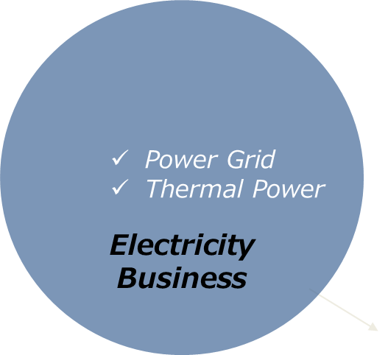
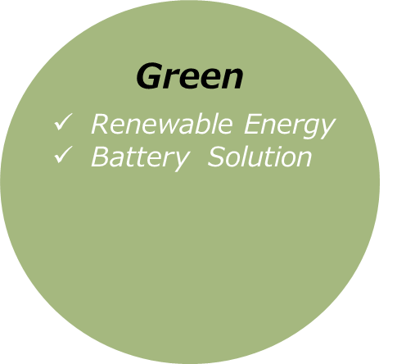
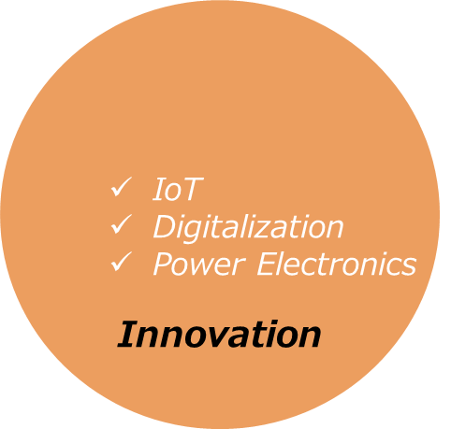
TEPCO: who are we? (2)
Paradigm shifting to:
“the Green & Innovation (G&I)”
Key techs & applications
Utility Scale
Battery Energy
Storage System (BESS)
Renewable Energy Control Centre
(RECC)
Distributed Generations
Big data O&M

Slide 4
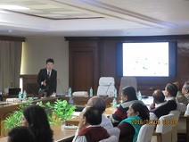
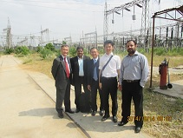
TEPCO: who are we? (3)
We know you;
  28 projects in India.
  2 year analysis in Rajasthan.

Slide 5
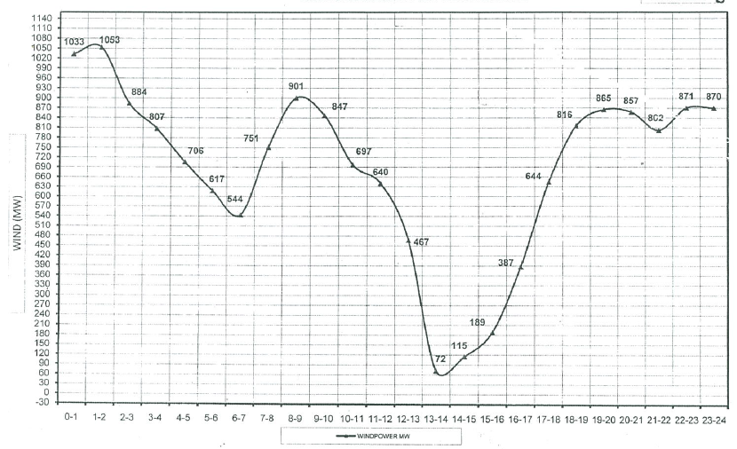
Knowledge through analysis in Rajasthan
Solar is smaller but wind is higher fluctuation to cause imbalance.
How to harness capricious wind generations is the key.
Rajasthan’s total daily Wind power summary in 2014 (MW)
900MW
72MW

Slide 6
Proposing Solutions in Rajasthan
BESS × RECC
Make electricity to be storable
Make renewable energy to be tame

Slide 7
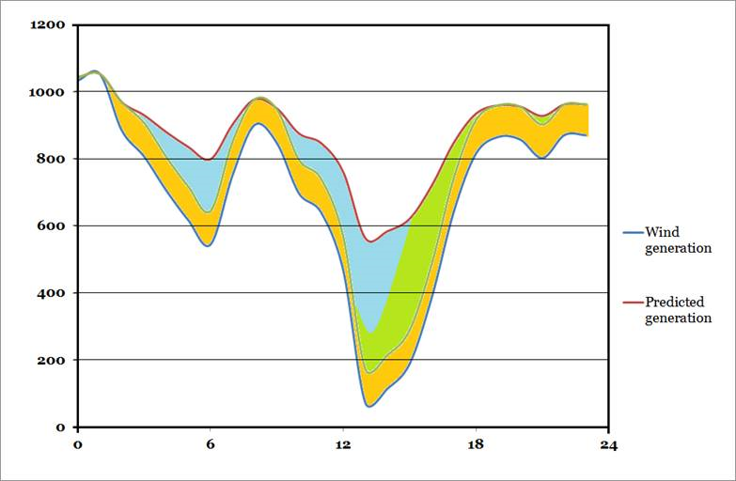
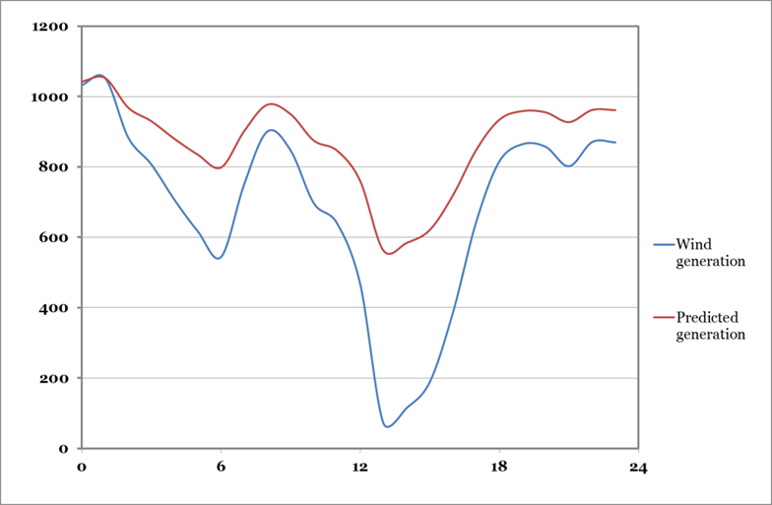
Proposing Solutions in Rajasthan: BESS X RECC
Absorb fluctuation in a gentle way.
Suitable capacity size, shorter term construction period.
Reduce fuel cost & CO2.
BESS
Actual
generation
Reserve Capacity
Predicted
generation
Standby Capacity Dispatch
Standby Capacity

Slide 8
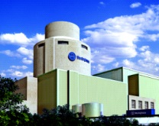
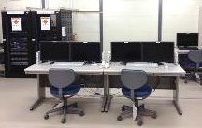


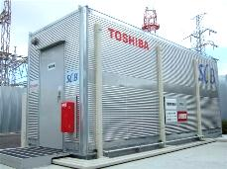
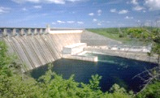
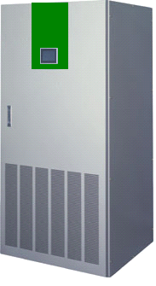

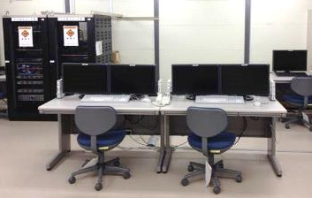
Proposing Solution in Rajasthan : BESS X RECC
Supervises and aggregates the RE resources.
Meets suitable supply and demand balance by utilizing BESS.
Nuclear power
generation plant
PCS
SCADA or TSC
Solar power generation
System linkage apparatus
Electric power company system
Thermal power generation plant
PCS
Hydro power/
pumped hydro
generation plant
RECC
BESS
Power grid
Supervisory control system
(Renewable Energy Control Centre)
PCS
Communication grid
PCS
Wind power generation
BESS
PCS
PCS
Solar power generation
Wind power generation

Slide 9

Proposing Solutions in Rajasthan : BESS X RECC
TEPCO has already a concreate proposal of the demo project, based on 2 year analysis.
<Assumed Specifications>
Power Type Battery(Lithium-ion Battery)
- Output : 2MW
- Capacity: 1MWh
Capacity Type Battery(NAS Battery)
- Output : 0.8MW
- Capacity: 4.8MWh
BESS
3m
SLDC/RECC
PCS (for Capacity Type Battery)
Capacity Type Battery
6m
Monitoring,
Controlling
Auxiliary Facilities
(Step-up Transformer, etc.)
10m
6m
3m
PCS (for Power Type Battery)
Power Type Battery
2.4m
3m
Substation
Power Type Battery
2.4m
3m
7m
3m
4m
3m
12m
3m
3m
35m

Slide 10
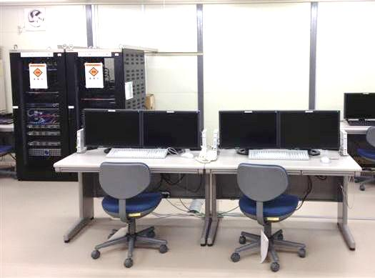
Proposing Solution in Rajasthan: BESS X RECC
TEPCO also has an overall system configuration diagram of RECC for the demo project.
RECC Server
RECC
SLDC
RECC
Server
HMI-1
HMI-2
SLDC
Server
HMI-1
HMI-2
Network
- Actual wind generation output
- Wind generation’s prediction data
System Image of RECC
- State of charge (SOC)
Site-A
Site-B
Site-N
Local Controller
Trans., etc
Local Controller
Trans., etc
Local Controller
Trans., etc
PCS
Battery Storage
PCS
Battery Storage
PCS
Battery Storage
Battery charging/discharging control

Slide 11
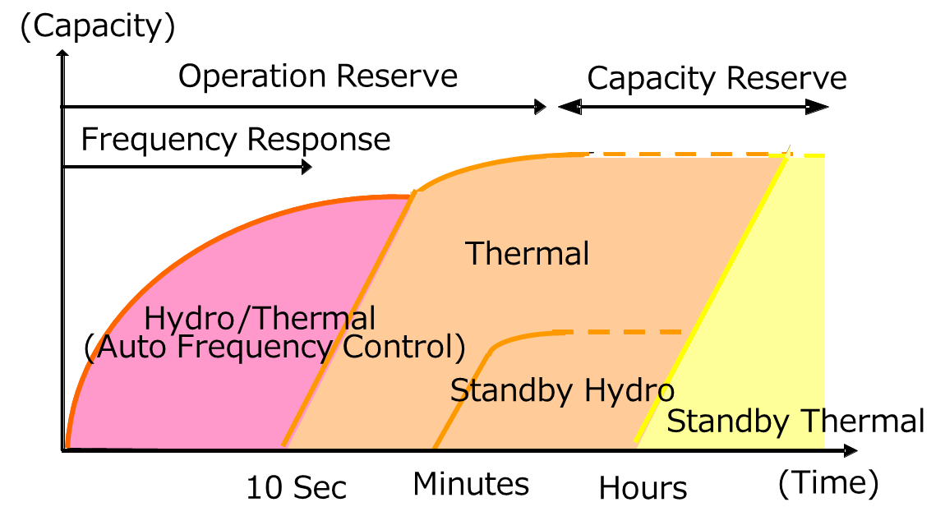
Great potential of BESS
Also contribute to a future ancillary market.
BESS
More flexible and cost-effective power source

Slide 12



TEPCO Rajasthan aur Bharat ke bijali kshetra ki safalta mei
yogdaan karna chaahta hain.
Dhanyawaad！

